Slide 1
Angular 17
Lesson 17—Binding and Events

Slide 2

What is a Template Model
How Angular17 binding works and the types of bindings
Understand Angular2 built-in directives
Basics of Webpack and SystemJS

Slide 3
Binding and Events
Topic 1—Template Model

Slide 4
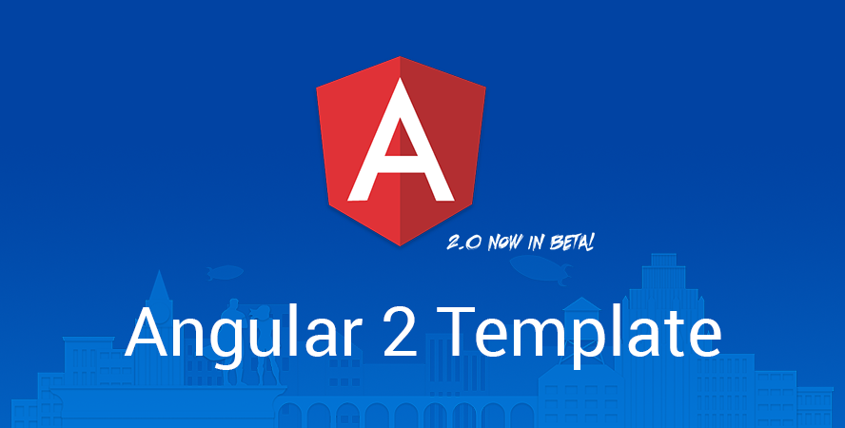
Templates
Angular Application manages access to users through the interaction between the component class instance (Component) and its user-facing template.

Slide 5
Templates—MVC With Angular 17
The Model-View-Controller (MVC) is an architectural pattern which segregates an application into three logical components.
Model: The Model corresponds to all the data-related logic.
Model
View: The View is used for all the UI logic of the application.
View
Controller
Controller: Controller acts as a connection between Model and View to process all the business logic and data manipulation-related tasks.

Slide 6

Templates
You will be familiar with component/template duality if you have worked on Model-View-Controller (MVC) or Model-View-ViewModel (MVVM).
MVC
View
Model
HTML
2 – way Data Binding
2 – way Data Binding
CSS
2 – way Data Binding
View
JavaScript
Services
Servers

Slide 7
Templates
In Angular 17, the component plays the part of the controller and the template represents the view.
Templates
View
Model
Components
Controller
Angular 17 templating system provides a syntax to express the dynamic part of HTML.

Slide 8
Templates
In Angular 17, a component needs to have a view.
Controller
Input
Output
View
To define view, you can define a template inline (using template) or in a separate file (using templateUrl).

Slide 9
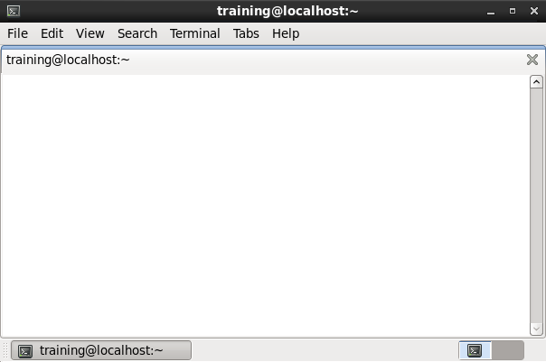
HTML in Templates
<html>
<head>
<title> </title>
</head>
<body>
</body>
</html>
HTML is the language of the Angular template.
Almost all HTML syntax is valid template syntax.
Important Points:
The <script> element is a notable exception; it is forbidden as it carries the risk of script injection attacks.
If <script> is ignored, a warning appears in the browser console.
Some legal HTML tags like <html>, <body>, and<base> have no role.

Slide 10
Templates Syntax
>_
training@localhost:~
import {Component} from 'angular2/core'; @Component({ selector: 'cars-app', template: '<h1>Welcome</h1>' }) export class CarsApp {}
Template Inline
>_
training@localhost:~
import {Component} from 'angular2/core';
@Component({
selector: 'cars-app',
templateUrl: 'components/cars/cars.component.html'
})
export class CarsApp {}
Separate file

Slide 11
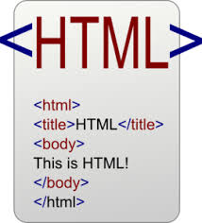
Templates Symbols
A template helps to render HTML with some dynamic parts, depending on the data.
It allows you to express data, property binding, event binding, and templating concerns.
To be able to express those behaviors, Angular 17 comes with its own symbols:
{{ }}
[]
()
#
*
Interpolation
Property Binding
Event Binding
Variable Declaration
Structural Directives

Slide 12


Lab—Demo
START LAB

Slide 13
Binding and Events
Topic 2—Binding

Slide 14

Binding and Component Data Binding
Binding is a mechanism for coordinating between what users see and data values in the application.
Binding
While pushing values to and pulling values from HTML, it will be easier to write, read, and maintain the application if you turn these chores over to a binding framework.

Slide 15

Binding and Component Data Binding
We need to declare bindings between sources and target HTML elements to let the framework perform the task.
Source
Declare Bindings
Binding
Target

Slide 16
Binding
Angular provides many types of data binding.
{{Data binding}}
Binding types can be grouped into three categories that are classified based on the direction of data flow between:
Source-to-view
View-to-source
In the two-way sequence it is ’view-to-source-to-view’
Notes:
Types of Binding supported by Angular 17 are:

Slide 17
Binding
Types of Binding supported by Angular 17 are:
Property Binding
Class Binding
Style Binding
Event Binding
Two-Way Binding
Component Binding
Notes:
Types of Binding supported by Angular 17 are:

Slide 18
Property Binding
Every DOM property can be written via special attributes on HTML elements using square brackets []. An HTML attribute can start with anything.
Angular 17 maintains the properties and attributes in sync when you use them, so if you are familiar with Angular 1.x directives, such as ng-hide, you can work directly with the hidden property and no more ng-hide is needed.
<div ng-hide="isHidden">Hidden element or not?</div>
The most common property binding sets an element property to a component property value.
>_
training@localhost:~
<img [src]="heroImageUrl">
<button [disabled]="isUnchanged">Cancel is disabled</button>
Notes:
Component to view

Slide 19
Lab—Demo
Property Binding
START LAB

Slide 20
Class Binding
You can add and remove CSS class names from an element's class attribute with a class binding.
Class binding syntax resembles property binding. Instead of an element property between brackets, start with the prefix class, optionally followed by a dot (.) and the name of a CSS class: [class.class-name].
The following examples show how to add and remove the application's "special" class with class bindings. Here's how to set the attribute without binding:
<!-- standard class attribute setting-->
<div class="bad curly special">Bad curly special</div>
Class binding syntax resembles property binding. Instead of an element property between brackets, start with the prefix class, optionally followed by a dot (.) and the name of a CSS class: [class.class-name].
<!-- reset/override all class names with a binding-->
<div class="bad curly special“[class]="badCurly">Bad curly</div>
Notes:
Component to view

Slide 21
Lab—Demo
Class Binding
START LAB

Slide 22
Style Binding
You can set inline styles with a style binding.
Style binding syntax resembles property binding. Instead of an element property between brackets, start with the prefix style, followed by a dot (.) and the name of a CSS style property: [style.style-property].
<button [style.color]="isSpecial ? 'red': 'green'">Red</button>
<button [style.background-color]="canSave ? 'cyan': 'grey'" >Save</button>
Some style binding styles have a unit extension. The following example conditionally sets the font size in “em” and “%” units.
<button [style.font-size.em]="isSpecial ? 3 : 1" >Big</button>
<button [style.font-size.%]="!isSpecial ? 1170 : 170" >Small</button>
Notes:
Component to view

Slide 23
Lab—Demo
Style Binding
START LAB

Slide 24
Event Binding
The bindings directives you've met so far allow data to flow in one direction: from a component to an element.
Users don't just stare at the screen. They enter text into input boxes. They pick items from lists. They click buttons. Such user actions may result in a flow of data in the opposite direction: from an element to a component.
The only way to know about a user action is to listen for certain events such as keystrokes, mouse movements, clicks, and touches. You declare your interest in user actions through Angular event binding.
Event binding syntax consists of a target event name within parentheses on the left of an equal sign, and a quoted template statement on the right.
<button (click)="onSave()">Save</button>
Notes:
View to component

Slide 25
Lab—Demo
Event Binding
START LAB

Slide 26
Two-Way Binding
You often want to both display a data property and update that property when the user makes changes.
On the element side, it takes a combination of setting a specific element property and listening for an element change event.
Angular offers a special two-way data binding syntax for this purpose, [(x)]. The [(x)] syntax combines the brackets of property binding, [x], with the parentheses of event binding, (x).
The two-way binding syntax is really just syntactic sugar for a property binding and an event binding. Angular desugars the SizerComponent binding into this:
<my-sizer [size]="fontSizePx" (sizeChange)="fontSizePx=$event"></my-sizer>

Slide 27
Lab—Demo
Two-Way Binding
START LAB

Slide 28
Component Binding
Angular components use events to notify parent components that something has changed.
There’s no longer two-way data binding; it’s designed around a unidirectional data flow system that adopts a much more reasonable approach to application development.
Let’s understand the basics of parent-child and child-parent communication by introducing EventEmitter and @Output.
EventEmitter is an Angular2 abstraction, and its only purpose is to emit events in components.
@Output is used to define output property to achieve custom event binding.

Slide 29
Lab—Demo
Component Binding
START LAB

Slide 30
Binding and Events
Topic 3—Built-in Directives

Slide 31
Introduction to ngModel
It would be convenient to use two-way binding with HTML form elements like <input> and <select>. However, no native HTML element follows the x value and xChange event pattern.
NgModel - Two-way binding to form elements with [(ngModel)]
When developing data entry forms, you often both display a data property and update that property when the user makes changes.
Fortunately, the Angular NgModel directive is a bridge that enables two-way binding to form elements.
<input [(ngModel)]="currentHero.name">

Slide 32
Lab—Demo
ngModel
START LAB

Slide 33
Built-in Directives
Structural directives are responsible for HTML layout.
They shape or reshape the DOM's structure, typically by adding, removing, and manipulating the host elements to which they are attached.
Here, we discuss the common structural directives:
Nglf
Conditionally add or remove an element from the DOM
NgFor
Repeat a template for each item in a list
NgSwitch
A set of directives that switch among alternative views

Slide 34
Lab—Demo
Built-in Directives
START LAB

Slide 35
Binding and Events
Topic 4—Basics of Webpack and SystemJS

Slide 36
Webpack
Webpack is essentially a code bundler.
01
It takes your code, transforms and bundles it, then returns a new “compiled” version.
02
This is bundled in Angular CLI version.
03
Webpack is a very complex tool, and most people do not need to know how every part of it works.
04

Slide 37
Webpack
There are three key parts to a basic Webpack configuration.
Entry
Loaders
The starting point of your application
The transformations you want to make on your code
Output
Where you want your compiled code to go

Slide 38
SystemJS
SystemJS is a universal module loader capable of loading modules of different formats: AMD, CommonJs, globals. It works both in node and in the browser.
01
SystemJS is composed of an ES6 module loader polyfill and a compatibility layer that allow it to use different module formats.
02
SystemJS can be used independently of jspm, but it’s best to use the two tools together.
03
This is very powerful: we can use ES6 modules in production today in a transparent way. It works even in an ES17-only project (using the required syntax).
04

Slide 39
Angular 17 templating system provides a syntax to express the dynamic part of HTML.
Binding is a mechanism for coordinating what users see, with application data values.
AngularJS Built-in Directives are responsible for HTML layout.
Webpack is essentially a code bundler. It takes your code, transforms and bundles it, and then returns a new “compiled” version. SystemJS is a universal module loader capable of loading modules of different formats.

Slide 41
On the opposite side of event bindings (()) lie Angular's square-bracket syntax ([]) which signifies a______________.
1
property binding
class binding
style binding
a and b

Slide 42
On the opposite side of event bindings (()) lie Angular's square-bracket syntax ([]) which signifies a______________.
1
property binding
class binding
style binding
a and b
a.
On the opposite side of event bindings (()) lie Angular's square-bracket syntax ([]) which signifies a property binding.

Slide 43
Angular 17 can detect when component data changes, and then automatically re-renders the view to reflect that change.
2
True
False

Slide 44
Angular 17 can detect when component data changes, and then automatically re-renders the view to reflect that change.
2
True
False
a.
Angular 17 can detect when component data changes, and then automatically re-renders the view to reflect that change.

Slide 45
What are the code bundlers used in market?
3
Webpack
Grunt
Gulp
All of the above

Slide 46
What are the code bundlers used in market?
3
Webpack
Grunt
Gulp
All of the above
d.
Webpack, Grunt, and Gulp are the code bundlers that are used in market.

Slide 47
What are the possible ways for two-way data binding in Angular 17?
4
{(ngmodel)}
bindon-ngModel
Bind-src
a and b

Slide 48
What are the possible ways for two-way data binding in Angular 17?
4
{(ngmodel)}
bindon-ngModel
Bind-src
a and b
d.
{(ngmodel)} and bindon-ngModel are the possible ways for two-way data binding in Angular 17.

